Slide 1
Lesson 3: Machine Learning
Card controlled car (part 2)

Slide 2
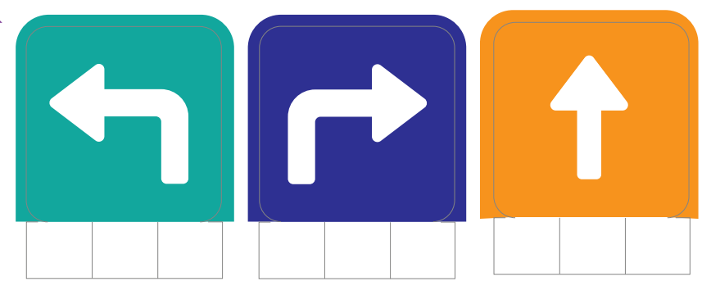
Requirements
A computer with webcam
A PictoBlox account
A printout of the require cards
Patience

Slide 3
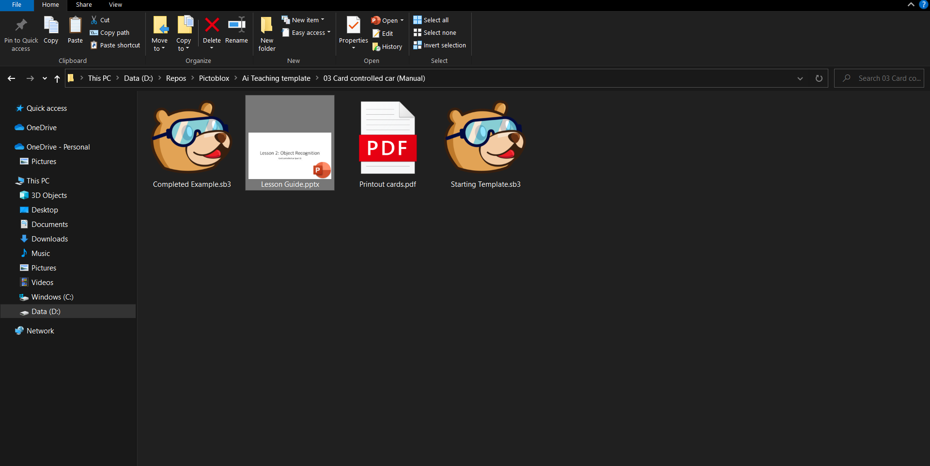

Open “Starting Template”

Slide 4
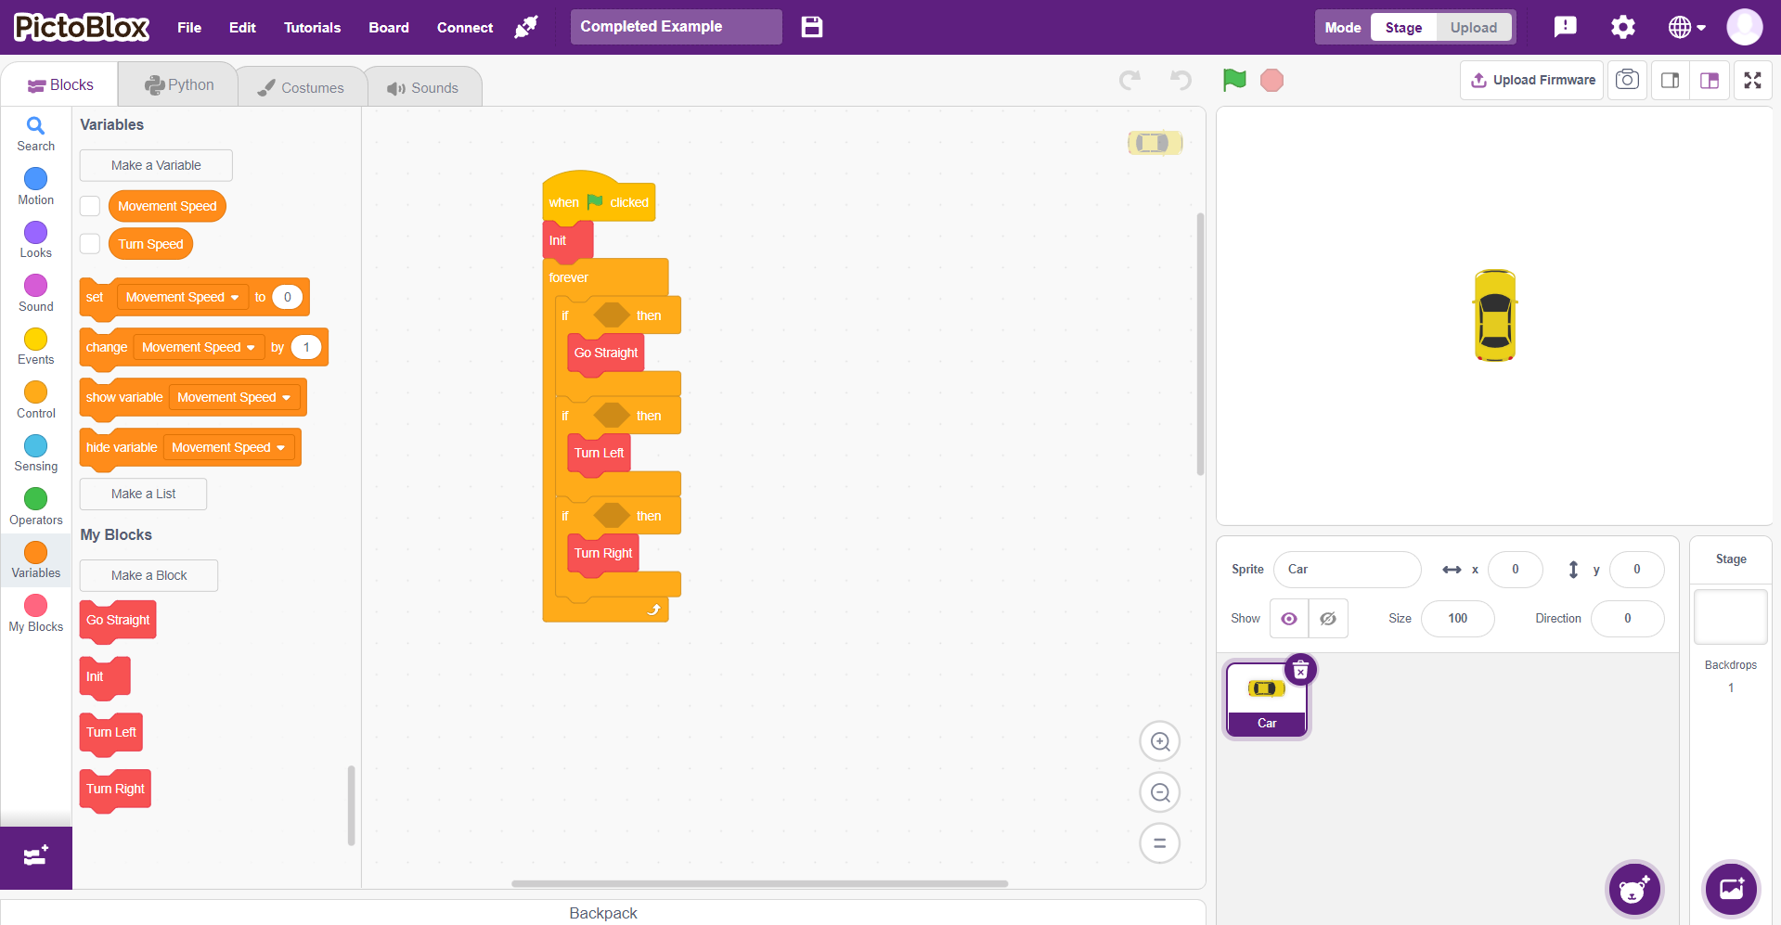
This is what you will see

Slide 5
Click on the purple box to open extensions

Slide 6
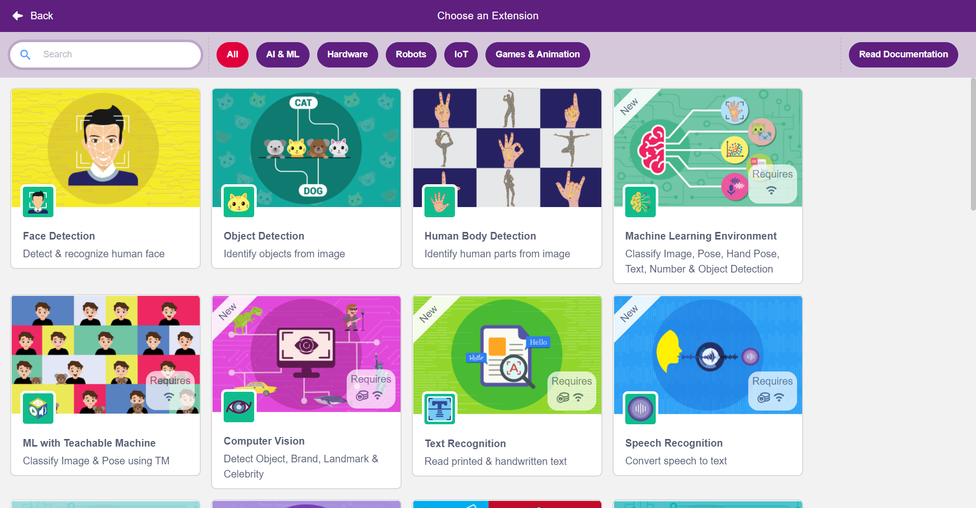
Click on “Machine Learning Enviroment”

Slide 7
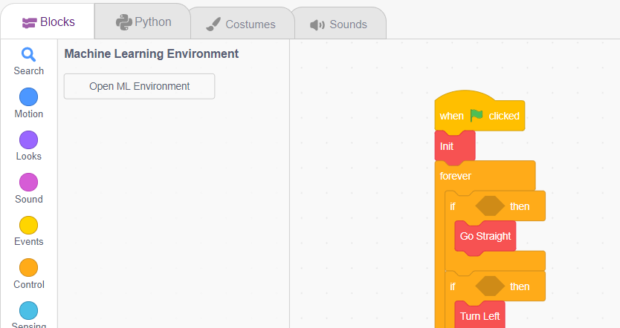

Go to “Open ML Enviroment”

Slide 8
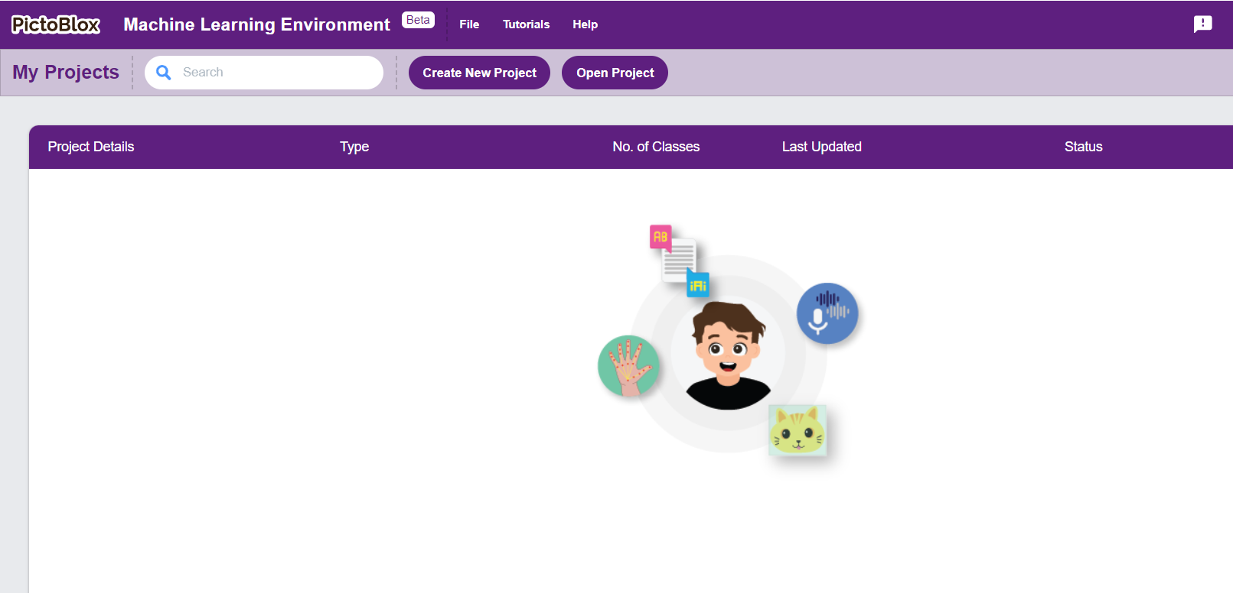
Click on “Create New Project”

Slide 9
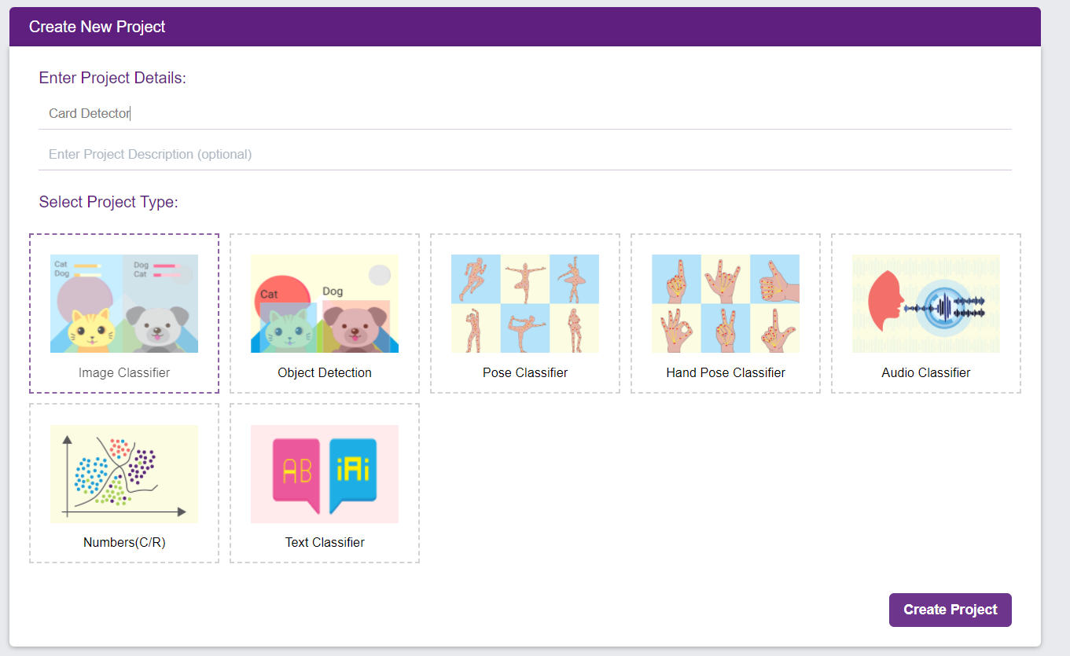
Give it a name (Here I use “Card Detector”)

Slide 10
Select “Image Classifier”

Slide 11
Click “Create Project”

